Slide 1
The Kentucky Association of Career Colleges and Schools
Annual Conference
August 23, 2013

Slide 2
Empathy, Professionalism and Customer Service

Slide 3
Who Are Our Customers?
Internal Customers – they are the colleagues we deal with on a daily basis.
External Customers – The people who buy our services.
“It is not the employer who pays the wages. Employers only handle the money.
It is the customer who pays the wages.”
Henry Ford

Slide 4
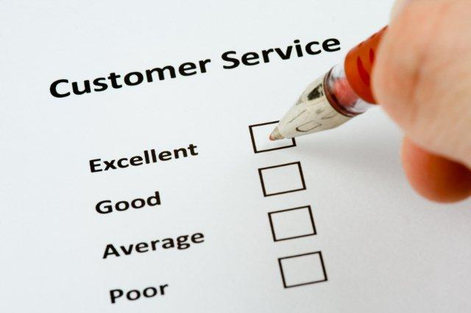
Customer Service Test
Would I be satisfied or pay for the service I just delivered?
“Rule 1: The customer is always right. Rule 2: if the customer is ever wrong, re-read Rule 1.” Stew Leonard, CEO Stew Leonard’s

Slide 5
Moments of Truth
There are certain key points of contact that determine a customer’s view of:
you
your department
your organization
These are called “Moments of Truth.”
“The more you engage with customers the clearer things become and the easier it is to determine what you should be doing.”
John Russell, President, Harley Davidson

Slide 6
Exercise
Think about a really good customer service experience you have had.
What were the “Moments of Truth?”
Why was it a good experience?
“Unless you have 100% customer satisfaction…you must improve.”
Horst Schultz

Slide 7
Exercise
Think about a really poor customer service experience you have had.
What were the “Moments of Truth?”
Why was it a bad experience?
“If you make customers unhappy in the physical world, they might tell 6 friends. If you make customers unhappy on the Internet, they can each tell 6,000 friends.”
Jeff Bezos

Slide 8
Keys to Customer Service in Organizations
No “Run Around”
Accurate information
Effective support systems & collaboration
Immediate solutions or referrals
“Owning” the customer’s agenda
Friendly environment
“The goal as a company is to have customer service that is not just the best but legendary.” Sam Walton, Founder Wal-Mart

Slide 9
Keys to Service for Individuals
Knowledgeable
Empowered
Empathetic
Not defensive
Driven to satisfy customers
Supported by solid systems
Professional
“Aim for service and success will follow.” Albert Schweitzer

Slide 10
Exercise
What types of service issues do we encounter with our campuses?
Are we fulfilling our customer’s needs?
As an organization
As a group
As individuals
If not, what more should we be doing?
“If we keep doing what we are doing, we are going to keep getting what we are getting.”
Stephen Covey

Slide 11
Principles for Service
Principle | Description
Honesty | You can trust that we will be honest in all the information provided.
Timeliness | We will respond to any inquiry or request as soon as possible and will work to resolve any complaint or outstanding issue as top priority.
Availability | You can reach us using multiple methods (phone, e-mail or chat) whenever we are open for business.
Security | You can have confidence that we respect and will protect the integrity, confidentiality and privacy of your information.
Consistency | You can expect excellent service every time, no matter the fault or issue.
Communication | We will actively communicate with you to raise your awareness of current issues and upcoming changes and the impact to you.
Quality | We have a continuous improvement culture for customer service and we actively seek ways to improve service and our value to you.
Needs/Empathy | We actively listen to you and consider your current and future needs in our service offerings, policies and processes and in planning and preparing for future changes that affect you.
Feedback | We regularly seek formal and informal feedback from you.
Compliance | We comply with all acts and regulations that govern our business.
Accountability | We take responsibility for our actions, services, and decisions.
Source: Colorado Technical University

Slide 12
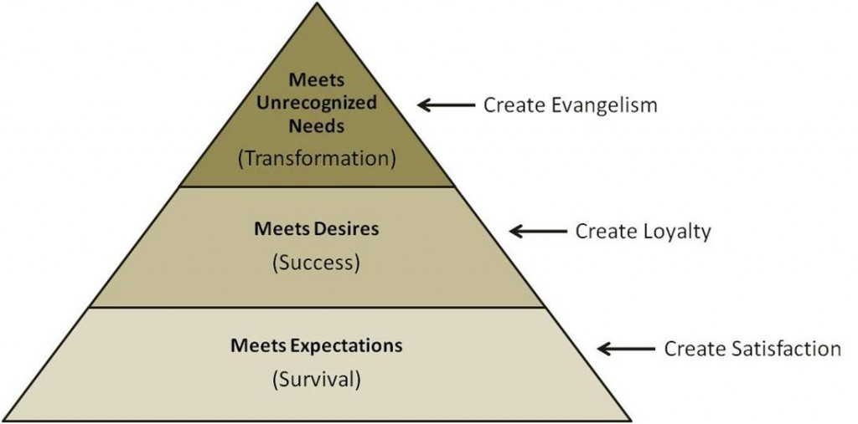
How do we create Evangelism in our Service to Campuses?
“There are no traffic jams along the extra mile.”
Roger Staubach

Slide 13
Survey results tell us that many students leave our schools because: they do not feel connected or that we are not truly concerned about them.

Slide 14
Empathy is at the Core
The Pathos Words…
Antipathy
Sympathy
Empathy
Apathy

Slide 15
The action of understanding, being aware of, being sensitive to, and vicariously experiencing the feelings, thoughts, and experience of another.
Empathy

Slide 16
Professional Empathy

Slide 17
A culture of Professionalism, Empathy and Customer Service is created one employee at a time!

Slide 18
The Conversation is Coaching
Establish Goals
Identify Barriers
Devise a Plan
Be Accountable

