Slide 1
CONFLICT: Let’s Get Into It!
Michael Traas

Slide 2
WHAT IS CONFLICT?

Slide 3
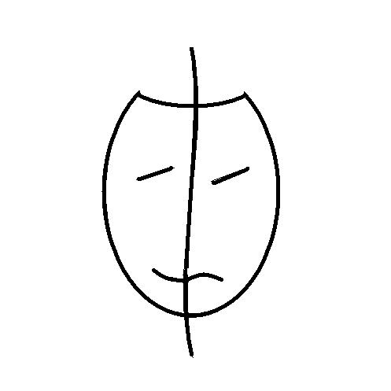

Slide 4
CONFLICT ≠ HOSTILITY

Slide 5
Theatrical Objectives are image-oriented action statements that typically begin with the word “To.”

Slide 6
Start with your organization’s Mission Statement.

Slide 7
Managing Positive Conflict:
1. Mutual Accountability
2. Dignity
3. Professionalism
4. Respect
5. Preparation

Slide 8
The 5 Rules of Engagement
1. One Topic at a Time.
2. Take Turns.
3. Ask, Don’t Accuse.
4. Take Responsibility.
5. Find the Right Path.

Slide 9
DON’T PUT STUDENTS IN THE MIDDLE
Support
Accountability

Slide 10
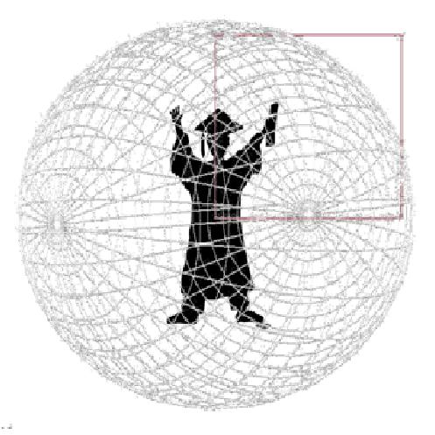
PUT STUDENTS AT THE CENTER

Slide 11
We enthusiastically embrace positive conflict to determine the best outcome for our students, our campus, and our community.

