Slide 1
Leveraging Technology Without Being Replaced by It:
Adapting the Flipped Classroom Model
Jeff Schillinger
August 2012
For a copy of the slides, please email me at:
jeffreyschillinger@hotmail.com

Slide 2
Most Important Point!!!
The teacher is the most important resource a student can leverage.
Just as a PowerPoint presentation is not the lecture, technology is not the teacher.

Slide 3
2nd Most Important Point!!!
Teacher must plan instruction that best meets students’ needed.
Our students are usually comfortable using technology.
We need to find ways to leverage that comfort.

Slide 4



The Three Generations
Baby Boomers
  Work-Centric
  Independent
  Goal-Oriented
  Competitive
  Structured
Generation X
  Value Work / Life Balance
  Individualistic
  Technologically Adept
  Flexible
Net Generation
  Family-Centric
  Team Oriented
  Achievement Oriented
  Tech Savvy
  Like
  Structured

Slide 5


Misconceptions
Not all Net Gens are experts in using technology at a high level.
openeducation.net

Slide 6

Misconceptions
Not all Net Gens are experts in using technology at a high level.
Not all Net Gens have the same mastery of or access to technology.
openeducation.net
openeducation.net

Slide 7
Misconceptions
Not all Net Gens are experts in using technology at a high level.
Not all Net Gens have the same mastery of or access to technology.
Intra-generational differences exist based on socioeconomic status
openeducation.net
openeducation.net
Mark Bullen BC Institute of Technology

Slide 8
Possible Issues
Net Gens tend to “cut and paste,” leading to “accidental plagiarism.”
openeducation.net

Slide 9
Possible Issues
Net Gens tend to “cut and paste,” leading to accidental plagiarism.
The technology gap between Net Gens and adults may be exaggerated.
openeducation.net
Mark Bullen BC Institute of Technology

Slide 10

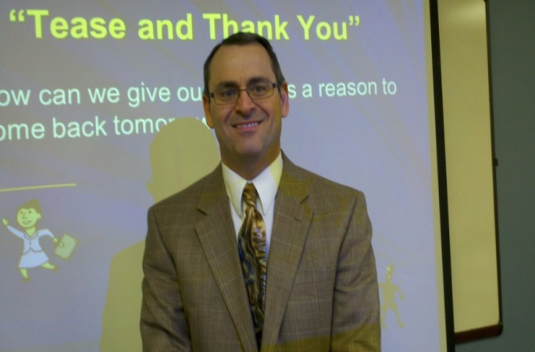
Attracting the Net Generation
Requires
an Infectious Message
Bueller?
Bueller?

Slide 11
Infectious Message
    Excellence – Must be the Best in Breed
    Uniqueness – One of a Kind Experience
    Aesthetics – Must be Appealing to the Senses
    Association – Linked to Organizations or Individuals who are respected

Slide 12
Infectious Message
    Engagement – Emotional Involvement
    Personification – Character and Personality

Slide 13
Discernible Value
    Cost – Value for the Money
      Functional Value – Meets Defined Needs
      Nostalgic Value - Evokes Sentimental Linkages
      Expressive Value – Other Users Value the Product or Process
      Opportunity Cost – Are they willing to give up something else they like for this?

Slide 14
Familiar Delivery
The Net Generation is Self-Teaching.
Those of us that are older need to develop that skill
Technology provides resources for self-teaching

Slide 15
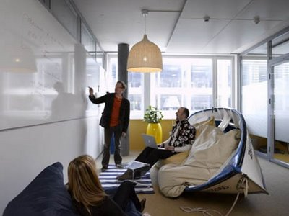
Teaching the Net Generation

Slide 16
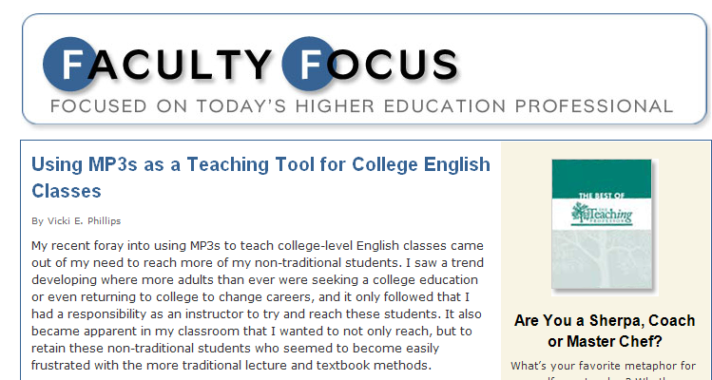
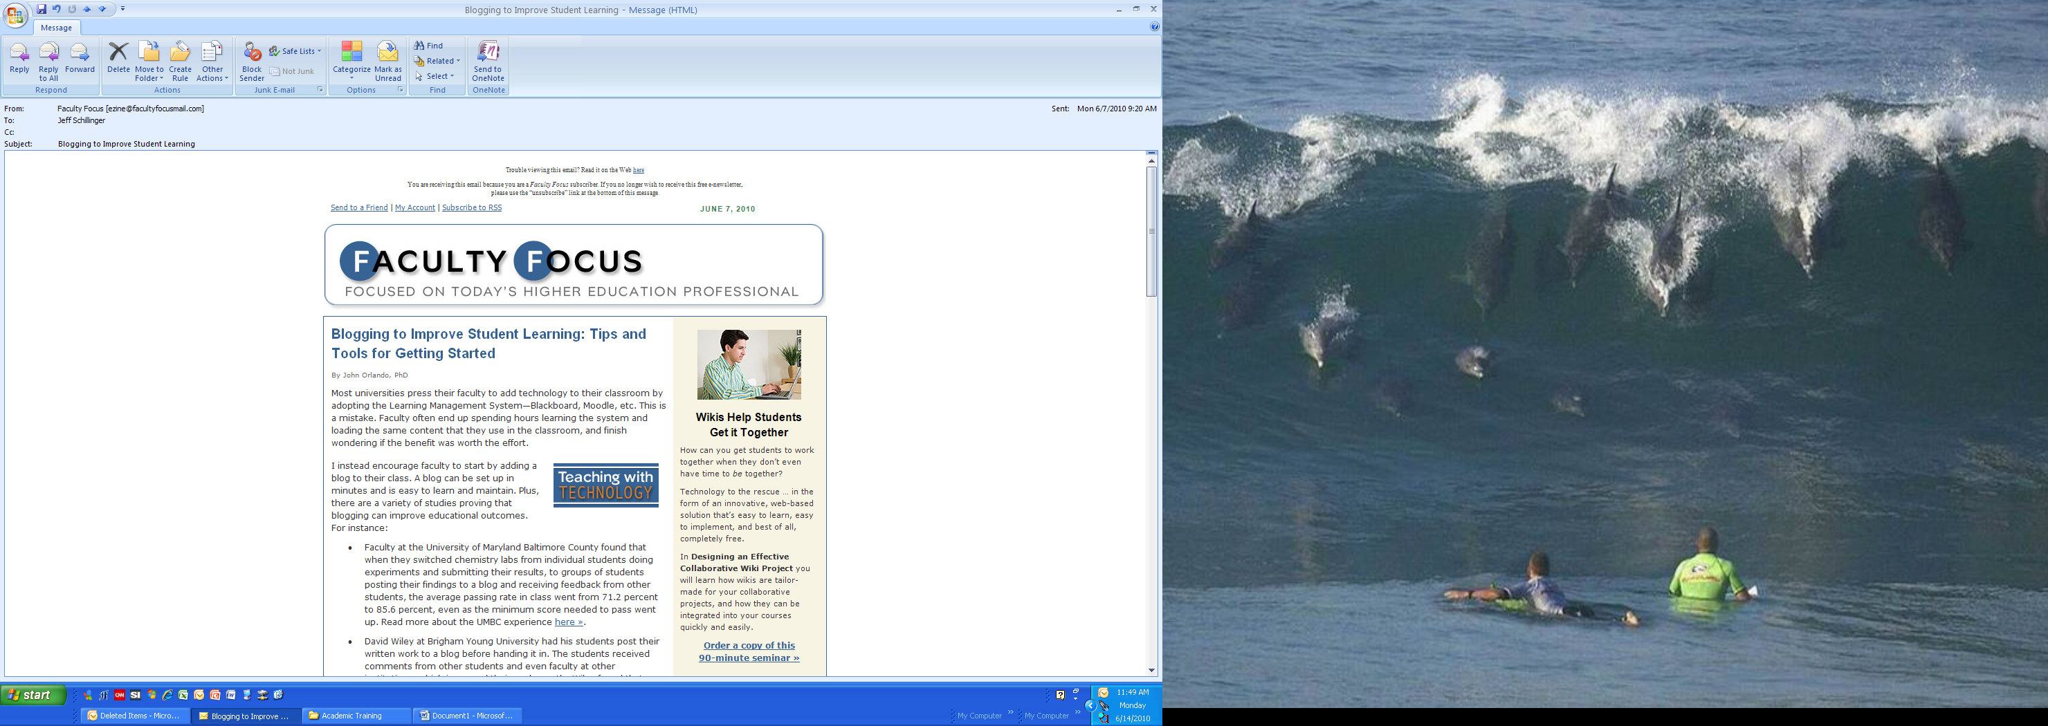

Slide 17
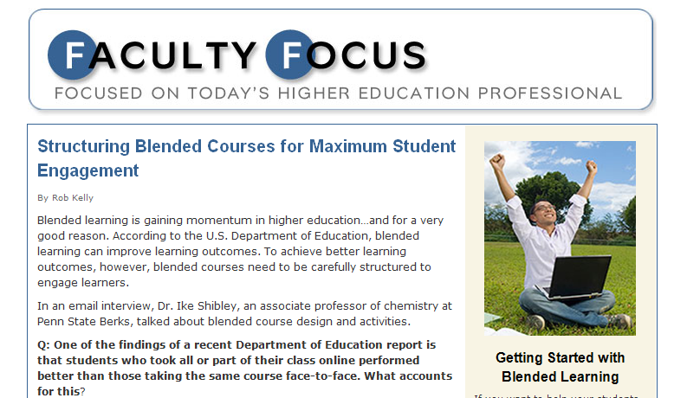
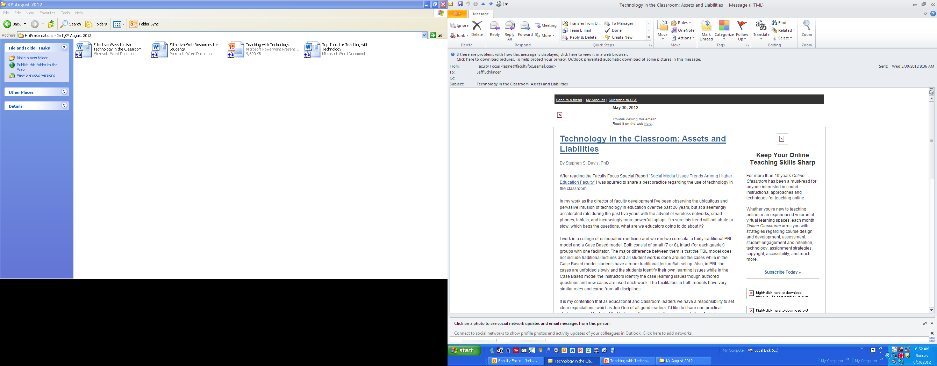

Slide 18

Flipping the Classroom

Slide 19
What is a Flipped Classroom?
A flipped classroom is one in which students experience much of the content outside of the classroom before the class meeting and use time in the classroom for interaction, application and evaluation.

Slide 20
Flipped Classroom
Ideally, there is course content available to students through technology organized for the particular courses.
A standard online course can serve students well here.

Slide 21
Flipped Classroom
If the full course is not available through an organized online line course, it is still possible to leverage the flipped classroom model.
Faculty members need to identify available resources and provide students with the links.

Slide 22
Flipped Classroom Benefits
Increase in student motivation to come to class prepared – reward behaviors you want!!
Student who miss class will still have access to and be responsible for the course material

Slide 23
Flipped Classroom Benefits
Students can build learning guides for use in future classes.
Students can identify appropriate online resources for you!

Slide 24

What is available on the web?

Slide 25
YouTube Math Lesson

Slide 26
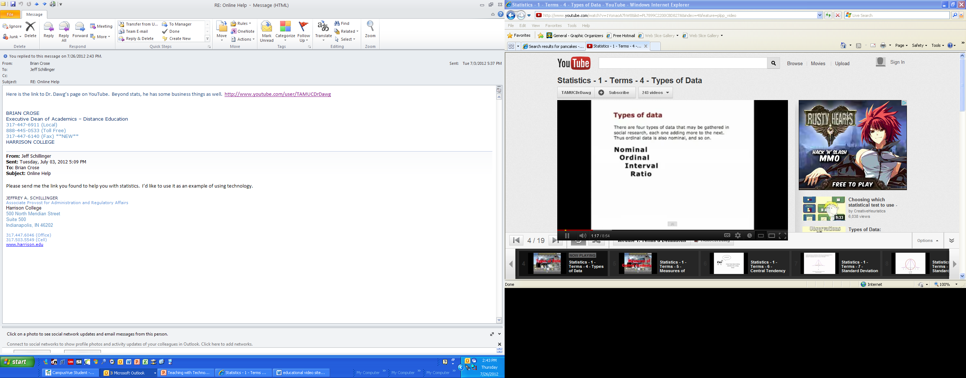
Dr. Dawg YouTube

Slide 27
Some Samples
Federal Resources for Educational Excellence
Math Topics
  Numbers and Operations
  Measurement
  Algebra
  Geometry
  Data Analysis
http://free.ed.gov/index.cfm

Slide 28
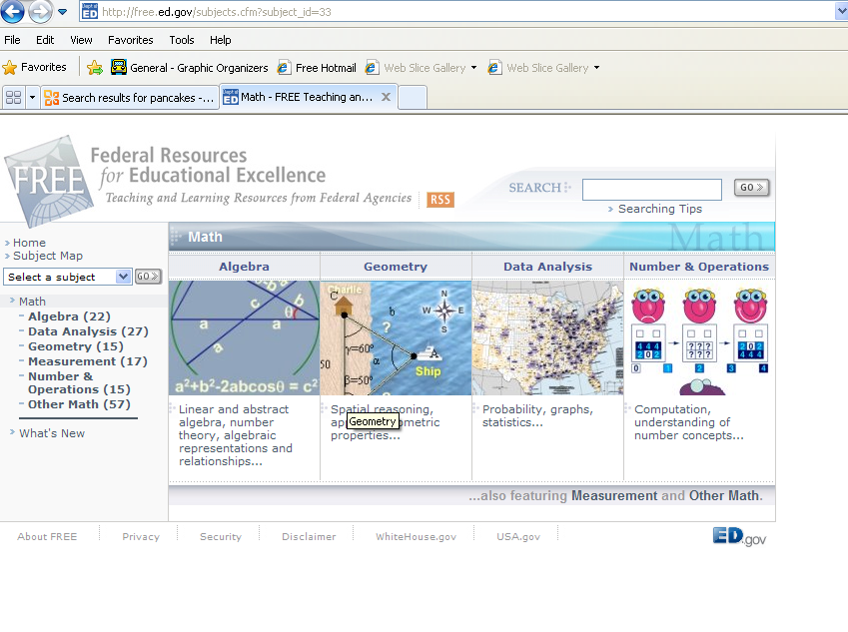

Slide 29
Samples
Kahn Academy http://www.khanacademy.org/
Think.com
Youtube

Slide 30
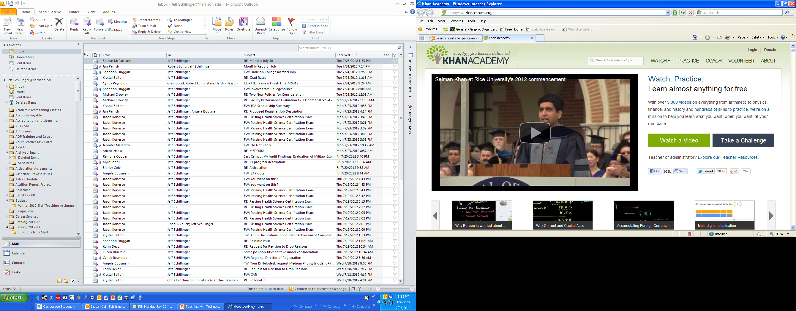

Slide 31
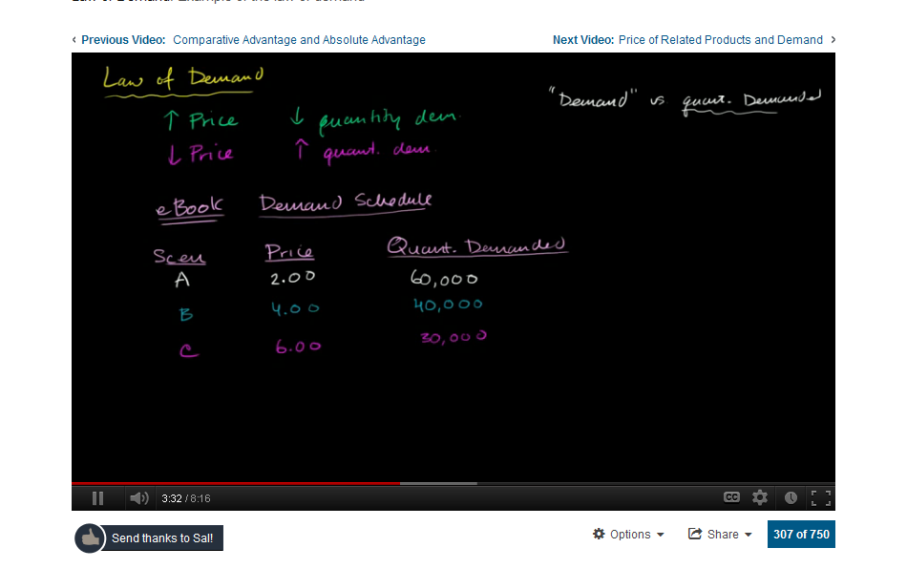
http://www.khanacademy.org/finance-economics/microeconomics/v/law-of-demand

Slide 32
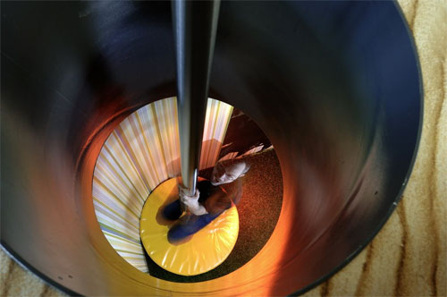
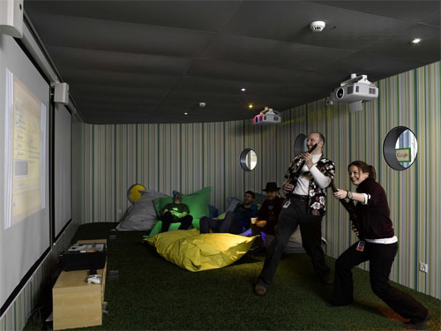
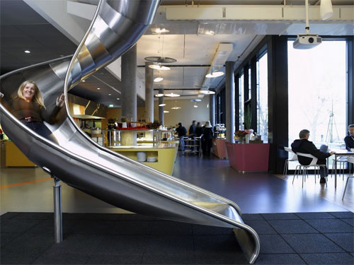
Tips for Getting the Most From Technology

Slide 33
Provide Students with a Compelling Reason to Use the Technology
  Does your use of technology add something to the class that would be impossible without it?
    Safe way to practice?
    Topics not covered in text or lecture
    Review tools from prerequisite courses
    New perspectives and opinions
    Expert testimony

Slide 34
Provide Students with a Compelling Reason to Use the Technology
  If you were a busy student what would make you bother to learn and use the technology?
    Extra Incentives for using the technology?
    Making it count?

Slide 35
Specific Teaching Strategies
Simulations
Games
  Jeopardy, etc.
Ignitor Questions
Webquests
Goanimate videos
Conversation grids

Slide 36
Teaching Tips
Webquests - Teacher poses a question and the students search for answers on the web.
Teachers provide background information
Teacher provides questions (choices are best)
Teacher provides assessment criteria so that students know how they will be graded
Teacher describes how the information found will be shared and used in the course

Slide 37
Webquest
List all the U.S. presidents who served in the 20th or 21st century?

Slide 38
Teaching Tips
Listen to and converse with your students
  In-class
  Learning management system
  Class web page
  Social media

Slide 39
Teaching Tips
Learn and teach a process of discovery
  Laboratory
  Field trip
  Library
  Web-quest

Slide 40
Teaching Tips
Teach students to think critically
  Evaluate sources
  Confirm the story
Support and facilitate collaboration
  In-class
  Learning management system
  Class web page
  Social media

Slide 41
Teaching Tips
Include peer instruction and facilitate learning communities
Embrace computer-aided instruction. Search for technology-based simulations
Schedule shorter activities due to shorter attention spans

Slide 42
Teaching Tips
Teach to multiple learning and intake styles.
  Every objective has to be experienced through multiple methods.
  Use multiple assessment strategies instead of just tests.
Provide stimulating visuals.
  Over 2/3 of Net Gens are visual learners.
  Give auditory instruction in short bursts.

Slide 43
Handouts
Effective Web Resources for Students
  Free web resources for students to use to reinforce learning
Effective Ways to Enhance Learning with Technology
  50 things that can work in or out of the classroom

Slide 44
Handouts
Top 35 Free Tools for Teaching with Technology
  Free online systems and software to support learning
Effective Web Resources for Students
  Free web resources for students to use to reinforce learning

Slide 45
THANK YOU!

